Slide 1
Building the Transfer Tool Box
Presented by the Iowa Association for College Admission Counseling – Transfer Committee
01
Notes:
Speaker - Introduction/Welcome, Alyssa Ploeger

Slide 2
Presenters
Tim Hauber
Assistant Director for Transfer Recruitment
Iowa State University
Alyssa Ploeger
Career Advantage Specialist
Des Moines Area Community College
Rachell Setsodi
Associate Director of Transfer Admission
Drake University
Claire Waletzki
Transfer Admissions Graduate Assistant
Iowa State University
Notes:
Speaker – Tim Hauber, Transfer Committee Chair

Slide 3
Notes:
Speaker - Alyssa
Overview and goals of presentation

Slide 4
Mentimeter
What do you hope to learn from this session to share with your students (and guardians)?
Scan the QR code to answer the prompt.

Slide 5
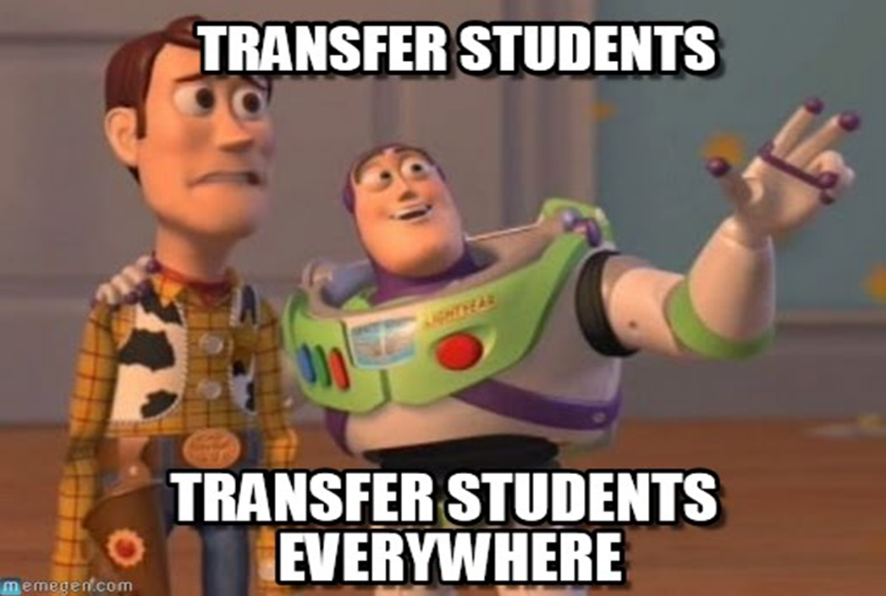
Defining a Transfer Student
A freshman applicant: any student who has not completed any college credit after graduating from high school.
A transfer applicant: any student who has completed at least one hour of college credit after graduating high school.
*Important note: Courses taken through a community college during high school & the summer prior to attending a 4-year institution do not make an incoming freshman a transfer student
Notes:
Speaker – Tim & Rachelle
Post High School vs. Concurrent

Slide 6
Types of College Credit Programs
AP
Dual Enrollment
PSEO
Notes:
Alyssa?

Slide 7
Trends in Dual Credit
According to the “Annual Condition of Iowa’s Community Colleges” joint enrollment in Iowa Community Colleges reached record high of 49,890 high school students accounting for 408,323 semester hours.
37.6% of total enrollees
22.8% of total credits
Iowa is one of the national leaders in percentage of jointly enrolled students.
Notes:
Speaker- Tim

Slide 8
Trends in Dual Credit
Transfer Credits of Freshmen direct from High School
(including transfer and PSEO credits)
 | 0 | 1 to 23 | 24 or more | Total | % 24 or more
2013 | 2,898 | 2,460 | 731 | 6,089 | 12.0%
2014 | 2,777 | 2,525 | 743 | 6,045 | 12.3%
2015 | 2,862 | 2,571 | 803 | 6,236 | 12.9%
2016 | 2,055 | 3,109 | 1,163 | 6,327 | 18.4%
2017 | 1,858 | 2,925 | 1,162 | 5,945 | 19.5%
2018 | 1,800 | 2,910 | 1,337 | 6,047 | 22.1%
2019 | 1,555 | 2,736 | 1,309 | 5,600 | 23.4%
2020 | 1,574 | 2,244 | 1,253 | 5,071 | 24.7%
2021 | 1,867 | 2,318 | 1,202 | 5,387 | 22.3%
2022 | 2,131 | 2,233 | 1,364 | 5,728 | 23.8%
Notes:
Speaker- Tim

Slide 9
Transfer Credit Limitations
Regents
Iowa Private Colleges
Maximum of 65 credits hours from a CC
Can transfer more than 65 credit hours from a 4-year institution; must receive last 32 credit hours from degree seeking institution
60 to 66 credits with AA degree
Maximum of 94 credits accepted and /or last 32 at host institution
Possible max of 24 with PSEO, AP, IB toward degree (can vary between institutions)
Maximum of 16 credit hours with vocational credit
Notes:
Speaker – Tim and Rachelle
- Students attending DMACC after high school do not need to send transcripts. Students need to fill out a new student application, complete orientation, etc.

Slide 10
Will I lose credits if I transfer?
Reasons courses won’t transfer
Failed/incomplete courses
Course wasn’t required for a degree
Course was taken more than once
Course was taken at an institution that wasn’t accredited
Taken as Pass/Fail
Remedial or developmental courses
ESL (generally no credit, or not applied towards degree)
Sequenced courses
Notes:
Speaker – Tim, Rachelle
Refer to transfer definition sheet (emailed to students prior)

Slide 11
Questions students should ask:
If I transfer college credits, will I receive freshman or transfer scholarships?
Can I take college courses the summer between high school graduation and entering the institution and still be considered an incoming freshman?
Would it be beneficial to receive my Liberal Arts AA/AS Degree before transferring?
How will the courses I have taken transfer into my respective program/major?
What are the foreign language requirements? (Transfer vs. Freshman)
Does my college GPA transfer? (GPA requirements College vs. Program )
What is the time it takes to complete a degree after transferring?
Are ACT/SAT scores required if I transfer?
If I enter the military after high school, can I enroll as a freshman later?
Notes:
Speaker – Alyssa & Shelby (handout sent to students before and after presentation)
Questions students should be asking when exploring institutions.
Able to print off an unofficial Degree Audit from myDMACC.
Students should work with CA academic advisor if they would like to take summer courses.

Slide 12
High School Course | DMACC Course Name | DMACC Course # | ISU Transfer Course
Accounting II | Accounting Fundamentals | ACC 111 | ACCT 1T (elective)
Bus and Personal Marketing | Career Development Skills | ADM 221 | career tech
Intro to Horticulture | Soil Fertility | AGH 106 | HORT 221
Computer Aided Drafting | Architectural Drafting I | ARC 114 | career tech
Drafting | Intro to Comp Aided Drafting | CAD 119 | career tech
Advanced Composition | Composition I | ENG 105 | ENGL 150
Environmental Science | Environmental Science | ENV 115 | BIOL 173
Math for Liberal Arts | Math for Liberal Arts | MAT 110 | MATH 105
Finite Mathematic | Finite Mathematics | MAT 141 | MATH 104
Statistics | Elementary Statistics | MAT 157 | STAT 101
Funding of Web Programming | Intro to HTML & CSS | WDV 101 | career tech
Notes:
Speaker – Tim, Alyssa
Each school has their own page on the DMACC website
AP vs. DMACC Credit vs. AP & DMACC credit

Slide 13
What is the best transfer option for students?
Complete AA/AS Degree at a Community College
Transfer credit directly from high school to another institution
Notes:
Speaker – Tim, Shelby
**varies from student to student and the amount of credits students have earned while in high school**
Pros and cons of each:
Complete AA/AS Degree at DMACC/Community College
Save money
Participate in partnership programs
Cross Enrollment
Amenities of community college
Transfer Credit Directly from HS
Eligible for incoming freshman scholarships
Depending on the amount of credits student is bringing into the institution, able to make major specific courses
Attend 4-year institution directly out of high school

Slide 14
Optimizing your transfer credit experience
Cross enrollment
Articulation agreements
Reverse transfer
PTK

Slide 15
Availble resources
myDMACC and DegreeWorks
Academic Advisor
Courses offered at your high school
Transfer equivalency guides
Transferology, TRANSIT (homegrown systems), Plan-it
Transfer Plans, suggested 4 yr. academic plans
How to submit AP scores
Notes:
Speaker - Alyssa
***Links sent to students after presentation

Slide 17
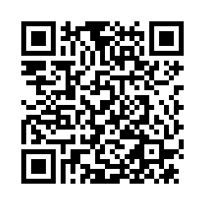
Thank you!
Tim Hauber
Iowa State University tfhauber@iastate.edu
Alyssa Ploeger
Des Moines Area Community College arploeger1@dmacc.edu
Rachelle Setsodi
Drake University rachelle.setsodi@drake.edu

